Slide 1
C++ Standard Library ‘Little Things’
Billy O’Neal, Visual C++ Libraries
bion@Microsoft.com
@MalwareMinigun
Notes:
35 minutes, code in 28 font

Slide 2
Announce giveaway stuff on this slide

Slide 3
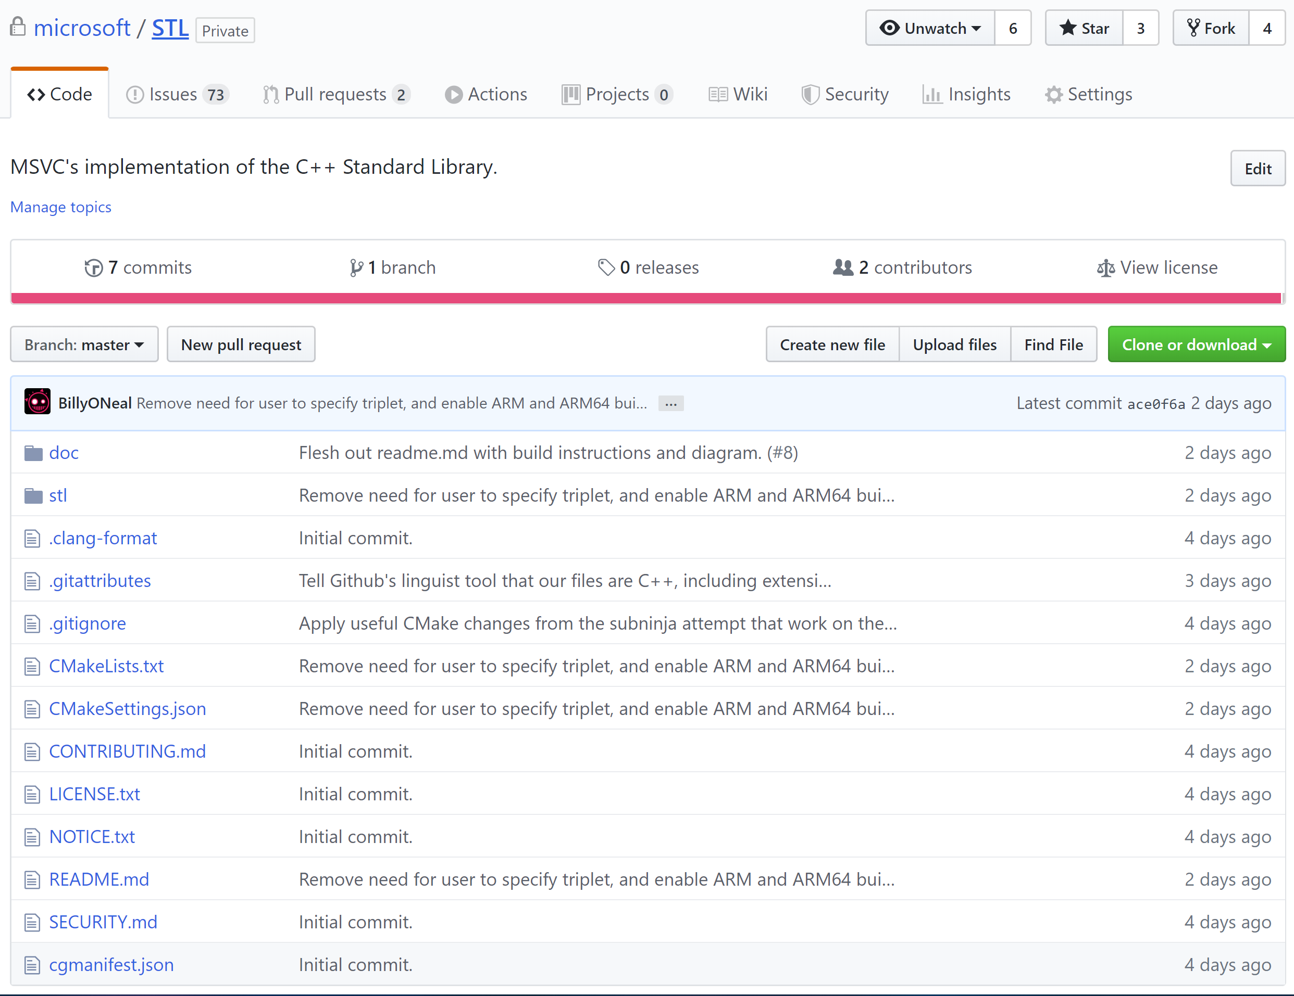

Slide 4
In this talk
Feature test macros (C++20)
starts_with + ends_with (C++20)
std::clamp (C++17)
std::exchange (C++14)
Variadic lock_guard (C++17)
Parallel Algorithms (C++17)
Associative contains (C++20)
Splicing Maps and Sets (C++17)
Unordered transparency (C++20)

Slide 5
Feature Test Macros (C++20)
Test if the compiler or standard library implements a given feature for the current build mode
Core features: http://eel.is/c++draft/cpp.predefined
Library features: http://eel.is/c++draft/support.limits.general
Examples of proper use from http://eel.is/c++draft/cpp.cond

Slide 6
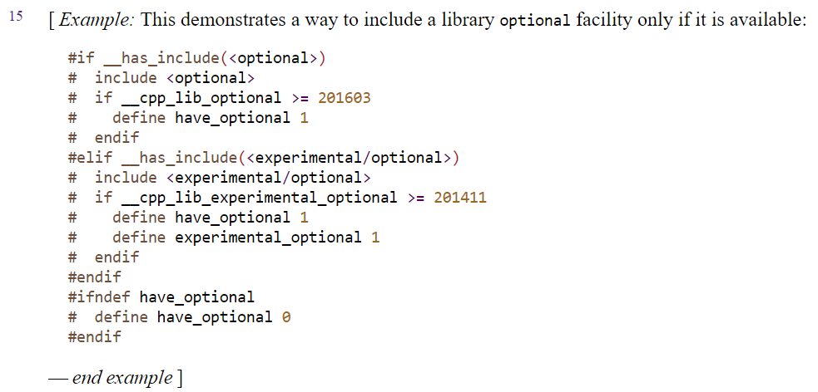
Feature Test Macros (C++20)

Slide 7
starts_with and ends_with (C++20)
Exactly what it says:
using namespace std::string_view_literals;
constexpr auto s = "hello world"sv;
static_assert(s.starts_with("hello"sv));
static_assert(!s.ends_with("hello"sv));
static_assert(!s.starts_with(" world"sv));
static_assert(s.ends_with(" world"sv));

Slide 8
std::clamp (C++17)
#include <algorithm>
constexpr int a = std::clamp(1234, 10, 20);
constexpr int b = std::clamp(11, 10, 20);
constexpr int c = std::clamp(0, 10, 20);
static_assert(a == 20);
static_assert(b == 11);
static_assert(c == 10);

Slide 9
std::exchange (C++14)
Equivalent to moving out a T, and move assigning over it
template <class T, class Other = T>
T exchange(T& val, Other&& new_val) {
T old_val = static_cast<T&&>(val);
val = static_cast<Other&&>(new_val);
return old_val;
}

Slide 10
std::exchange (C++14)
== std::move
template <class T, class Other = T>
T exchange(T& val, Other&& new_val) {
T old_val = static_cast<T&&>(val);
val = static_cast<Other&&>(new_val);
return old_val;
}
== std::forward
== std::move!

Slide 11
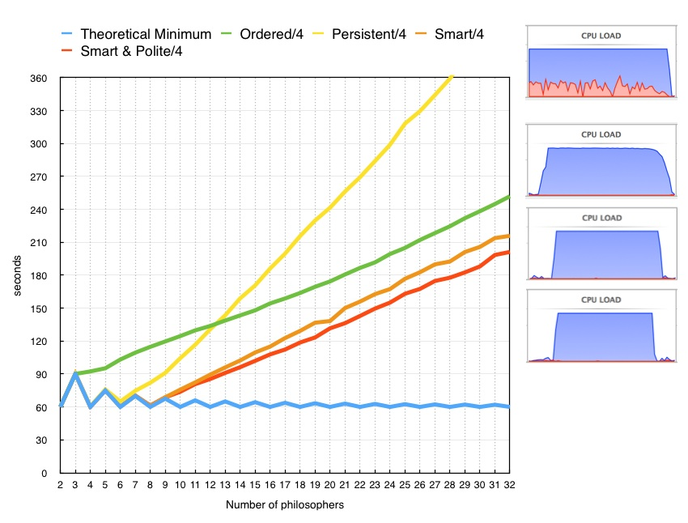
Variadic lock_guard: scoped_lock (C++17)
Takes multiple locks using a deadlock avoidance algorithm
Oblivious to mutex type, scheduler, etc.
More efficient than defining a lock ordering, see http://howardhinnant.github.io/dining_philosophers.html
template<class... MutexTypes>
class scoped_lock;
Notes:
http://howardhinnant.github.io/dining_philosophers.html#Explanation

Slide 12
scoped_lock (C++17)
struct DataValue {
mutable std::shared_mutex m;
int theValue;
};
void modify_both(DataValue& a, DataValue& b) {
std::scoped_lock lock(a.m, b.m); // takes both
// mutexes without deadlock
std::swap(a.theValue, b.theValue);
// both mutexes are unlocked upon exiting the scope
}

Slide 13
Parallel Algorithms (C++17)
std::sort(a, b, pred) => std::sort(std::execution::par, a, b, pred)
See blog post for more nitty gritty:
https://devblogs.microsoft.com/cppblog/using-c17-parallel-algorithms-for-better-performance/

Slide 14
Parallel Algorithms (C++17)
state.PauseTiming();
vector<T> data(r0);
fill_with_random(data);
state.ResumeTiming();
sort(execution::par,
data.begin(), data.end(), less<>{});

Slide 15
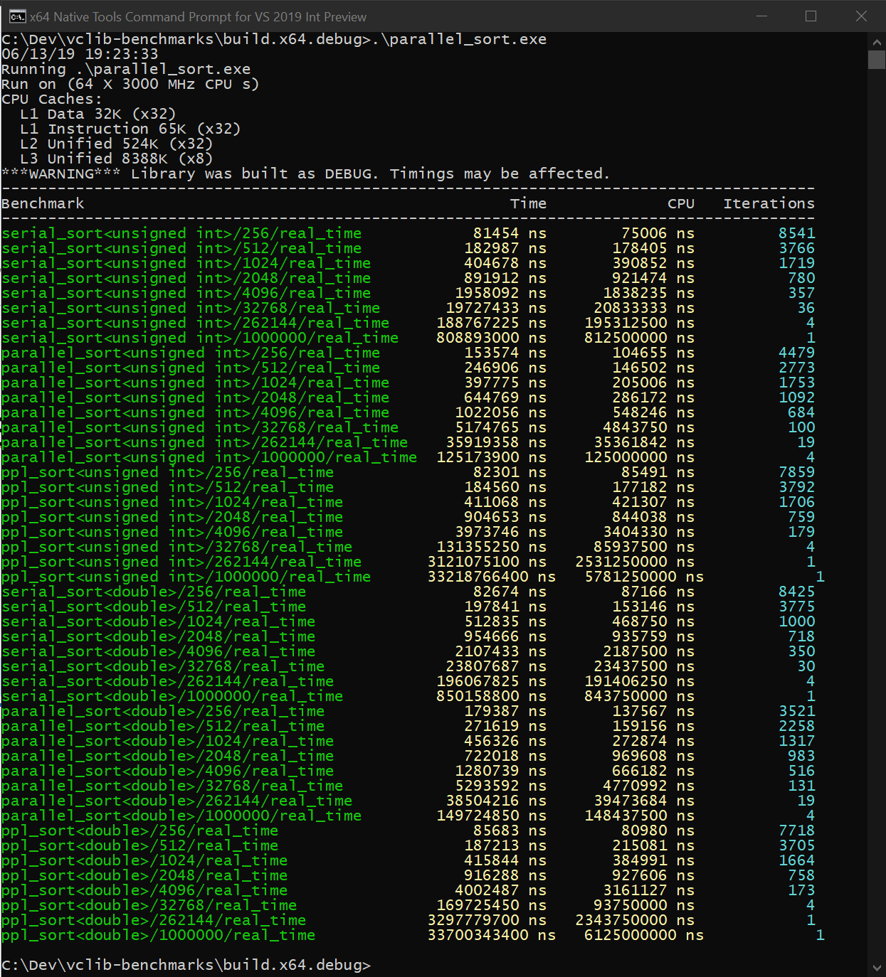
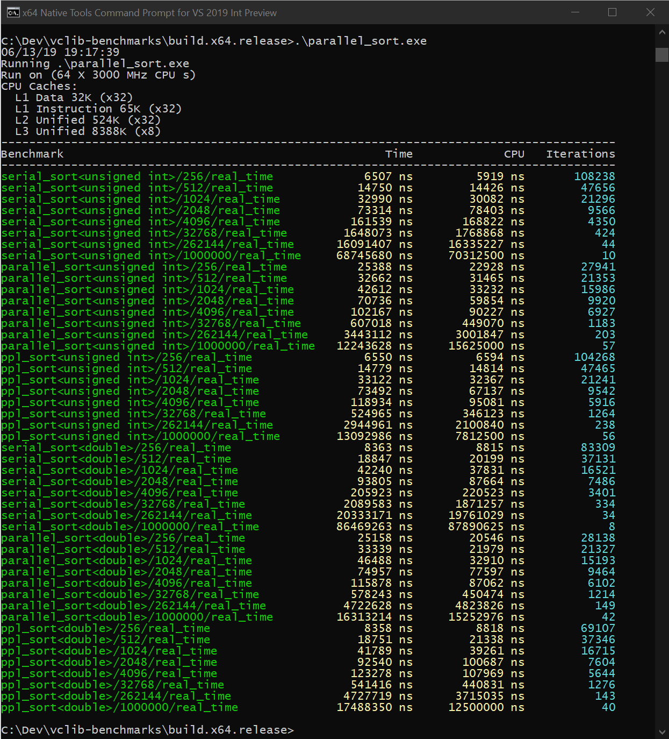
Parallel Algorithms (C++17)

Slide 16
Parallel Algorithms (C++17)
Debug
element count | 256 | 512 | 1024 | 2048 | 4096 | 32768 | 262144 | 1000000
serial, unsigned int | 81454 | 182987 | 404768 | 891912 | 1958092 | 19727433 | 188767225 | 808893000
parallel, unsigned int | 153574 | 246906 | 397775 | 644769 | 1022056 | 5174765 | 35919358 | 125173900
Relative Time | 1.885407715 | 1.349308967 | 0.982723437 | 0.72290652 | 0.52196526 | 0.262313145 | 0.190283869 | 0.154747167
Win, Times | 0.530389259 | 0.741120102 | 1.01758029 | 1.383304718 | 1.915836314 | 3.812237464 | 5.255306206 | 6.462153852
ppl, unsigned int | 82301 | 184560 | 411068 | 904653 | 3873746 | 131355250 | 3121075100 | 33218766400
Relative Time | 1.010398507 | 1.008596239 | 1.015564471 | 1.014285042 | 1.978326861 | 6.658506963 | 16.53398836 | 41.06694754
Win, Times | 0.989708509 | 0.991477026 | 0.984674069 | 0.985916147 | 0.505477644 | 0.150183818 | 0.060481475 | 0.024350483

Slide 17
Parallel Algorithms (C++17)
Debug
element count | 256 | 512 | 1024 | 2048 | 4096 | 32768 | 262144 | 1000000
serial, unsigned int | 81454 | 182987 | 404768 | 891912 | 1958092 | 19727433 | 188767225 | 808893000
parallel, unsigned int | 153574 | 246906 | 397775 | 644769 | 1022056 | 5174765 | 35919358 | 125173900
Relative Time | 1.885407715 | 1.349308967 | 0.982723437 | 0.72290652 | 0.52196526 | 0.262313145 | 0.190283869 | 0.154747167
Win, Times | 0.530389259 | 0.741120102 | 1.01758029 | 1.383304718 | 1.915836314 | 3.812237464 | 5.255306206 | 6.462153852
ppl, unsigned int | 82301 | 184560 | 411068 | 904653 | 3873746 | 131355250 | 3121075100 | 33218766400
Relative Time | 1.010398507 | 1.008596239 | 1.015564471 | 1.014285042 | 1.978326861 | 6.658506963 | 16.53398836 | 41.06694754
Win, Times | 0.989708509 | 0.991477026 | 0.984674069 | 0.985916147 | 0.505477644 | 0.150183818 | 0.060481475 | 0.024350483

Slide 18
Parallel Algorithms (C++17)
Debug
element count | 256 | 512 | 1024 | 2048 | 4096 | 32768 | 262144 | 1000000
serial, unsigned int | 81454 | 182987 | 404768 | 891912 | 1958092 | 19727433 | 188767225 | 808893000
parallel, unsigned int | 153574 | 246906 | 397775 | 644769 | 1022056 | 5174765 | 35919358 | 125173900
Relative Time | 1.885407715 | 1.349308967 | 0.982723437 | 0.72290652 | 0.52196526 | 0.262313145 | 0.190283869 | 0.154747167
Win, Times | 0.530389259 | 0.741120102 | 1.01758029 | 1.383304718 | 1.915836314 | 3.812237464 | 5.255306206 | 6.462153852
ppl, unsigned int | 82301 | 184560 | 411068 | 904653 | 3873746 | 131355250 | 3121075100 | 33218766400
Relative Time | 1.010398507 | 1.008596239 | 1.015564471 | 1.014285042 | 1.978326861 | 6.658506963 | 16.53398836 | 41.06694754
Win, Times | 0.989708509 | 0.991477026 | 0.984674069 | 0.985916147 | 0.505477644 | 0.150183818 | 0.060481475 | 0.024350483

Slide 19
Parallel Algorithms (C++17)
Release
element count | 256 | 512 | 1024 | 2048 | 4096 | 32768 | 262144 | 1000000
serial, unsigned int | 6507 | 14750 | 32990 | 73314 | 161539 | 1648073 | 16091407 | 68745680
parallel, unsigned int | 25388 | 32662 | 46212 | 70736 | 102167 | 607018 | 3443112 | 12243628
Relative Time | 3.901644383 | 2.214372881 | 1.400788118 | 0.964836184 | 0.632460273 | 0.36832 | 0.213972091 | 0.178100326
Win, Times | 0.25630219 | 0.451595126 | 0.71388384 | 1.036445374 | 1.581126978 | 2.715032 | 4.6735067 | 5.614812864
ppl, unsigned int | 6550 | 14779 | 33122 | 73492 | 118934 | 524965 | 2944961 | 13092986
 | 1.006608268 | 1.001966102 | 1.004001212 | 1.002427913 | 0.736255641 | 0.318533 | 0.183014512 | 0.1904554
 | 0.993435115 | 0.998037756 | 0.996014733 | 0.997577968 | 1.358223889 | 3.139396 | 5.464047571 | 5.250573093

Slide 20
Parallel Algorithms (C++17)
Release
element count | 256 | 512 | 1024 | 2048 | 4096 | 32768 | 262144 | 1000000
serial, unsigned int | 6507 | 14750 | 32990 | 73314 | 161539 | 1648073 | 16091407 | 68745680
parallel, unsigned int | 25388 | 32662 | 46212 | 70736 | 102167 | 607018 | 3443112 | 12243628
Relative Time | 3.901644383 | 2.214372881 | 1.400788118 | 0.964836184 | 0.632460273 | 0.36832 | 0.213972091 | 0.178100326
Win, Times | 0.25630219 | 0.451595126 | 0.71388384 | 1.036445374 | 1.581126978 | 2.715032 | 4.6735067 | 5.614812864
ppl, unsigned int | 6550 | 14779 | 33122 | 73492 | 118934 | 524965 | 2944961 | 13092986
 | 1.006608268 | 1.001966102 | 1.004001212 | 1.002427913 | 0.736255641 | 0.318533 | 0.183014512 | 0.1904554
 | 0.993435115 | 0.998037756 | 0.996014733 | 0.997577968 | 1.358223889 | 3.139396 | 5.464047571 | 5.250573093

Slide 21
Contains (C++20)
New member of maps and sets that does just what it says – bool to ask if an element is in the container
Alternative to find() != end() or count() != 0

Slide 22
Contains (C++20)
printf("find != end 24: %s\n",
s.find(24) != s.end() ? "true" : "false");
printf("find != end 67: %s\n",
s.find(67) != s.end() ? "true" : "false");
printf("count 24: %s\n", s.count(24) != 0 ? "true" : "false");
printf("count 67: %s\n", s.count(67) != 0 ? "true" : "false");
printf("contains 24: %s\n", s.contains(24) ? "true" : "false");
printf("contains 67: %s\n", s.contains(67) ? "true" : "false");

Slide 23
Splicing Maps and Sets (C++17)
Extract elements from maps or sets, and mutate them or reinsert them later
Combine maps and sets into each other with the merge member
No allocations

Slide 24
Splicing Maps and Sets (C++17)
Node-based containers
Not node-based
list (C++98/03)
forward_list (C++11)
(multi)set
(multi)map
unordered_(multi)set
unordered_(multi)map
array
deque*
vector
vector<bool>
string
bitset
valarray

Slide 25
Splicing Maps and Sets (C++17)
end

Slide 26
Splicing Maps and Sets (C++17)
head

Slide 27
Splicing Maps and Sets (C++17)
end

Slide 28
Splicing Maps and Sets (C++17)
buckets

Slide 29
Splicing Maps and Sets (C++17)
buckets

Slide 30
Splicing Maps and Sets (C++17)
buckets
end

Slide 31
Splicing Maps and Sets (C++17)
std::vector
std::list
buckets
end

Slide 32
Splicing Maps and Sets (C++17)
container::node_type
pointer to node
allocator

Slide 33
Splicing Maps and Sets (C++17)
using UnwindMapData =
UtcPool::map<T_ALLOC, EHSTATE, UWentry>;
for (auto &UWEntry : funcInfo.UnwindMap)
{
// Change entry to be keyed off new state
const_cast<T&>(UWEntry.first) = newState;
}

Slide 34
Splicing Maps and Sets (C++17)
using UnwindMapData =
UtcPool::map<T_ALLOC, EHSTATE, UWentry>;
for (auto &UWEntry : funcInfo.UnwindMap)
{
// Change entry to be keyed off new state
auto movedEntry =
funcInfo.UnwindMap.extract(UWEntry.first);
movedEntry.key() = newState;
funcInfo.UnwindMap.insert(move(movedEntry));
}

Slide 35
Splicing Maps and Sets (C++17)
std::set set1 = {1, 2, 4, 1000, 1234, -67, 1729};
std::set set2 = {-1, 2, 4, -1000, 1234, 7, -1729};
print_ints("set1", set1);
print_ints("set2", set2);
set1.merge(set2);
// set1 == {-1729, -1000, -67, -1, 1, 2, 4, 7, 1000,
// 1234, 1729}
// set2 == {2, 3, 1234}
print_ints("set1, after merge", set1);
print_ints("set2, after merge", set2);

Slide 36
Unordered Transparency (C++20)
void example(std::set<std::string>& s) {
s.find("hello world"); // implicitly allocates memory :(
s.find("hello world"sv); // doesn't compile X(
s.find(std::string("hello world"sv)); // allocates memory :(
}
void example(std::set<std::string, std::less<>>& s) {
s.find("hello world"); // doesn't allocate memory but strlen :/
s.find("hello world"sv); // doesn't allocate memory :D
}

Slide 37
Unordered Transparency (C++20)
Like C++14 transparent ordered associative containers extended to unordered containers
Then: std::map<std::string, int, std::less<>>
Now: std::unordered_map<std::string, int, ASpecialHash>

Slide 38
Unordered Transparency (C++20)
struct hasher {
// equal_to has is_transparent
using transparent_key_equal = std::equal_to<>;
std::size_t operator()(std::string_view sv) {
return std::hash<std::string_view>{}(sv);
}
};
void example(std::unordered_set<std::string, hasher>& s) {
s.find("hello world"); // doesn't allocate memory but strlen :/
s.find("hello world"sv); // doesn't allocate memory :D
}

Slide 39
(Insert other MS cppcon talks on this slide)

Slide 40
Thanks all!
Talk materials at https://github.com/BillyONeal/14_cpp_features_in_40_minutes

Slide 41
Backup Slides

Slide 42
Increasing safety of unions: std::variant (C++17)
Tagged / discriminated union which keeps track of which union member is active.
Multiples of the same type are allowed: variant<int, int, int>.
Supports visitation scenarios, useful in cases like collision modeling.

Slide 43
Increasing safety of unions: std::variant (C++17)
struct JsonArray {};
struct JsonObject {};
struct JsonNumber {};
std::variant<JsonArray, JsonObject, JsonNumber>
parse_json(const char*);
// expected the user to say "42", but said "{42}":
auto v = parse_json("{42}");
v.index(); // gets the active variant member index
std::get<JsonNumber>(v); // throws bad_variant_access
std::get<JsonObject>(v); // returns reference to the JsonObject
std::get<0>(v); // also bad_variant_access
std::get<1>(v); // ok
// destructor of the active variant member called automatically

Slide 44
Increasing safety of unions: std::variant (C++17)
Conversions are handled for you
std::variant<std::string, double> g() {
return "hello world";
}

Slide 45
Increasing safety of unions: std::variant (C++17)
#include <stdio.h>
#include <string>
#include <variant>
struct Success {};
struct Failure {
std::string message;
};
std::variant<Success, Failure> do_thing() {
if (2 + 2 == 5) { // for large values of 2?
return Failure{"Math is broken"};
}
return Success{};
}

Slide 46
Increasing safety of unions: std::variant (C++17)
int main() {
auto result = do_thing();
switch(result.index()) {
case 0: // active member is Success
puts("Success");
break;
case 1:
puts("Failure:");
puts(std::get<Failure>(result).message.c_str());
// variant took care of destroying the string inside
break;
}
}

Slide 47
Behavior for each type: std::visit
struct Visitor {
void operator()(const Success&) const {
puts("Success");
}
void operator()(const Failure& f) const {
puts("Failure");
puts(f.message.c_str());
}
};
std::visit(Visitor{}, do_thing());

Slide 48
std::visit passing through return types
#include <Windows.h>
struct HResultVisitor {
HRESULT operator()([[maybe_unused]] const Success& s) const {
return S_OK;
}
HRESULT operator()([[maybe_unused]] const Failure& f) const {
return E_FAIL;
}
};
extern "C" HRESULT __stdcall some_c_api_wrapper() noexcept {
return std::visit(HResultVisitor{}, do_thing());
}

Slide 49
Multiple variants: collision modeling
#include <stdio.h>
#include <variant>
struct LeftClick {};
struct RightClick {};
using ClickType = std::variant<LeftClick, RightClick>;
struct Button {};
struct Widget {};
struct TextBox {};
using TargetType = std::variant<Button, Widget, TextBox>;
void HandleCollision(const ClickType& click, const TargetType& target);

Slide 50
void HandleCollision(const ClickType& click,
const TargetType& target) {
struct Visitor {
void operator()(LeftClick, Button) const {
puts("Button was left clicked");
}
void operator()(LeftClick, Widget) const {
puts("Widget was left clicked");
}
void operator()(LeftClick, TextBox) const {
puts("TextBox was left clicked");
}
void operator()(RightClick, Button) const {
puts("Button was right clicked");
}
void operator()(RightClick, Widget) const {
puts("Widget was right clicked");
}
void operator()(RightClick, TextBox) const {
puts("TextBox was right clicked");
}
};
std::visit(Visitor{}, click, target);
}

